Slide 1

Global Air Pollution
Data 495 Data Science Capstone
Fallon Wynn
Professor: Steve Chesney
(Strebkov, n.d., “Polluted Planet Earth”, dreamstime.com)

Slide 2
Data Analysis Project Description
The data analytics problem that I will be analyzing is based on historical global air pollution trends and its’ future effect on public health.
Will identify countries with the highest and lowest air pollution.
Will compare air pollution in the U.S. with other countries.
Insights provided can be used by government agencies to make important decisions about regulations, policies, and legislature to further decrease air pollution in problematic geographic locations.

Slide 3
Project Importance
The dissemination of air pollutants is an ongoing global issue that has detrimental impacts on public health.
Even low levels of air pollution causes health problems (Hunter, 2020).
Pollutants such as, particulate matter, carbon monoxide, ozone, nitrogen dioxide and sulfur dioxide are of major public health concern (WHO, 2025, para. 2).
Air pollution was the second largest risk factor of deaths in 2021.
In 2021, air pollution was the cause of 8.1 million deaths worldwide (1 in 8 deaths).
709,000 of the total deaths from air pollution were children under the age of five (Health Effects Institute, 2024).

Slide 4
Data Set Description
Obtained the “Global Air Pollution Dataset” from the website Kaggle.
Consists of U.S. Air Quality Index (AQI) values for different pollutants for many cities world-wide (AirNow, n.d.; Muzdadid, 2022).
Real-time data was collected from elichens.com by the author Hasib Al Muzdadid.
The temporal coverage start date was 11/2/2022, but the data set was last updated on Kaggle in 2023 (Muzdadid, 2022).

Slide 5
Describe the Data
Consists of 23,463 rows of data and 12 columns.
The data includes 5 continuous (numerical) fields and 7 categorical fields (see Table 1.1 and 2 on next 3 slides for details).
427 rows of data that are missing the name of the country.
1 row of data that is missing the name of the city.
1 questionable outlier.
Class imbalance between the distribution of health risk classes (see Table 3 on slide 8).
There are not any duplicate entries.

Slide 6
Table 1.1
Examination of Continuous (Numerical) Fields
Name of field | Brief description | Minimum value | Maximum value | Average | Standard deviation | Potential Quality Issue? | Nulls | Outliers
AQI Value | The overall level of air pollution. | 6.0 | 500.0 | 72.01 | 56.06 | No | 0 | 0
CO AQI Value | The overall level of Carbon Monoxide pollution in the air. | 0.0 | 133.0 | 1.37 | 1.83 | Yes | 0 | 1
Ozone AQI Value | The overall level of Ozone pollution in the air. | 0.0 | 235.0 | 35.19 | 28.10 | No | 0 | 0
NO2 AQI Value | The overall level of Nitrogen Dioxide pollution in the air. | 0.0 | 91.0 | 3.06 | 5.25 | No | 0 | 0
PM2.5 AQI Value | The overall pollution level of Particulate Matter with a diameter of 2.5 micrometers or less in the air. | 0.0 | 500.0 | 68.52 | 54.80 | No | 0 | 0

Slide 7
Table 2: Examination of Categorical Fields
Name of field | Brief description | Number of categories | Potential Quality Issue? | Nulls | Outliers
Country | The name of the country. | Total: 23036 Unique: 175 | Yes | 427 | 0
City | The name of the city. | 23462 | Yes | 1 | 0
AQI Category | Good= 0-50; satisfactory air quality, which posed little to no risk. Moderate= 51-100; acceptable air quality that may pose some risk to very sensitive groups. Unhealthy for Sensitive groups= 101-150; Impacts the health of only sensitive groups. Unhealthy= 151-200; May impact the health of the general public, but may severely impact the health of sensitive groups. Very Unhealthy= 201-300; Health Alert: Increased risk for health impact for everyone. Hazardous= 301 and higher; Health warning of emergency condition: everyone more likely to have health impact. | 6 | No | 0
CO AQI Category | Good= 0-50; satisfactory air quality, which posed little to no risk. Moderate= 51-100; acceptable air quality that may pose some risk to very sensitive groups. Unhealthy for Sensitive groups= 101-150; Impacts the health of only sensitive groups. | 3 | No | 0 | 0
Ozone AQI Category | Good= 0-50; satisfactory air quality, which posed little to no risk. Moderate= 51-100; acceptable air quality that may pose some risk to very sensitive groups. Unhealthy for Sensitive groups= 101-150; Impacts the health of only sensitive groups. Unhealthy= 151-200; May impact the health of the general public, but may severely impact the health of sensitive groups. Very Unhealthy= 201-300; Health Alert: Increased risk for health impact for everyone. | 5 | No | 0 | 0

Slide 8
Table 2: Examination of Categorical Fields Continued
NO2 AQI Category | Good= 0-50; satisfactory air quality, which posed little to no risk. Moderate= 51-100; acceptable air quality that may pose some risk to very sensitive groups. | 2 | No | 0 | 0
PM2.5 AQI Category | Good= 0-50; satisfactory air quality, which posed little to no risk. Moderate= 51-100; acceptable air quality that may pose some risk to very sensitive groups. Unhealthy for Sensitive groups= 101-150; Impacts the health of only sensitive groups. Unhealthy= 151-200; May impact the health of the general public, but may severely impact the health of sensitive groups. Very Unhealthy= 201-300; Health Alert: Increased risk for health impact for everyone. Hazardous= 301 and higher; Health warning of emergency condition: everyone more likely to have health impact. | 6 | No | 0 | 0

Slide 9
Table 3: Counts of Air Quality Health Risk Categories
Name of field | Good | Moderate | Unhealthy for Sensitive Groups | Unhealthy | Very Unhealthy | Hazardous
AQI Category | 9688 | 9087 | 1568 | 2215 | 286 | 191
CO AQI Category | 23032 | 2 | 1 | 0 | 0 | 0
Ozone AQI Category | 20672 | 1419 | 488 | 404 | 52 | 0
NO2 AQI Category | 23020 | 15 | 0 | 0 | 0 | 0
PM2.5 AQI Category | 9950 | 8939 | 1601 | 2118 | 255 | 172

Slide 10
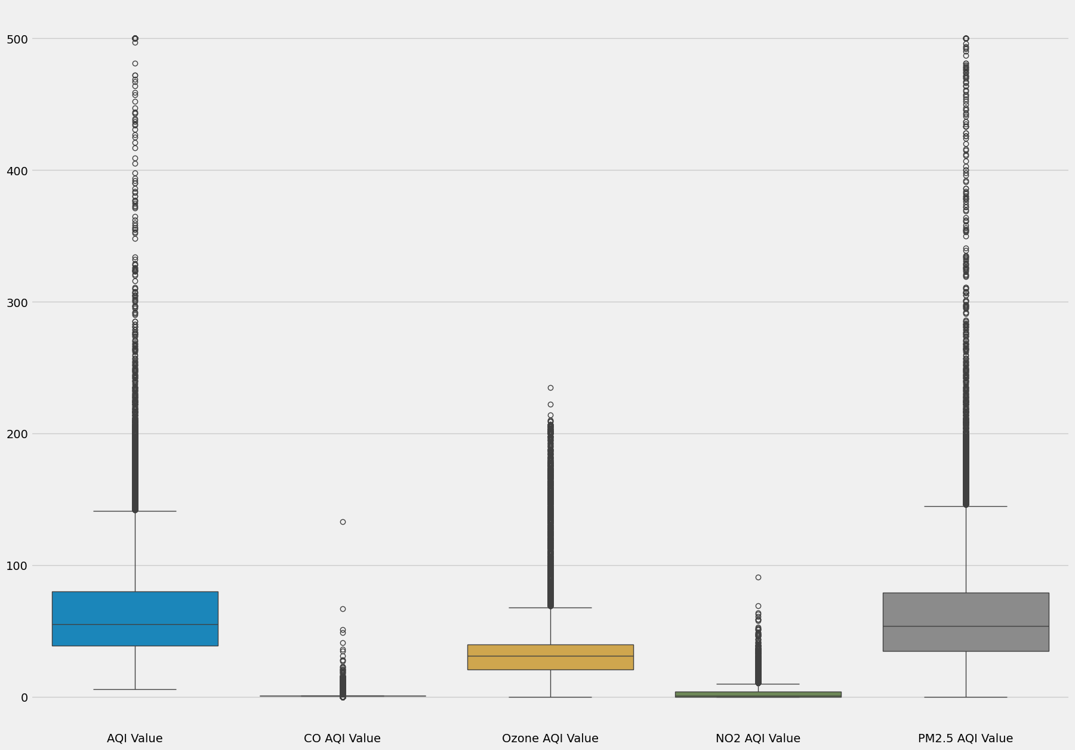
Visualization 1
This box plot provided important insights into the distribution of the data and the identification and investigation of possible outliers.
Overall, the distribution of data is different between the variables, except for the AQI Value and PM2.5 AQI Value which have very similar data distributions.
The CO AQI and the NO2 AQI values are on a much smaller scale and do not contribute much to the overall air pollution, while the Ozone AQI Value does make a contribution to the overall air pollution.

Slide 11
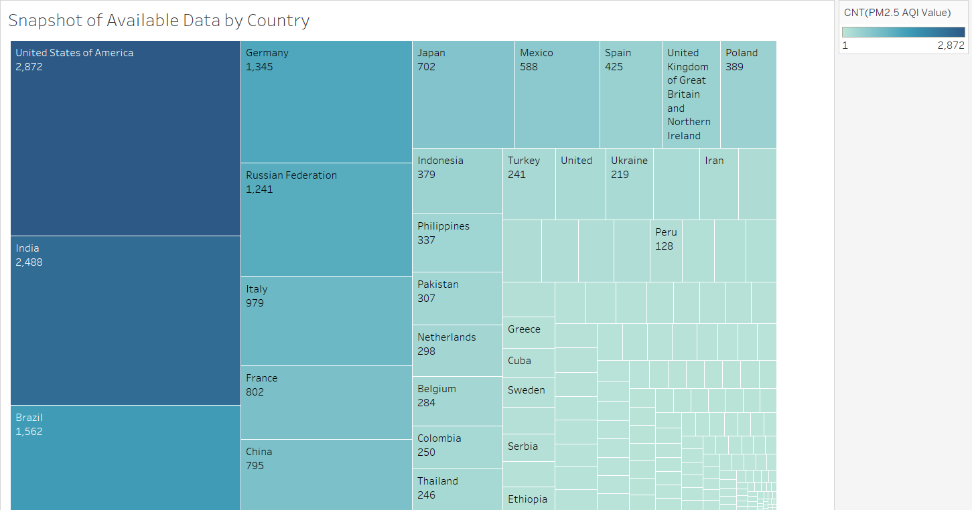
Visualization 2
This tree map visualization helps to illustrate a part-of-whole relationship between different countries in a hierarchal format (Tableau, 2025).
Shows that the data count is not equal for all countries and varies and differs significantly.
Data disparity could lead to bias in the machine learning models, especially the classification model.

Slide 12
Data Modeling
A multiple linear regression model can be used for quantitative forecasting of PM2.5 AQI Values and to study the relationship of the specific pollutants in a particular geographic region.
A classification model can be used for a qualitative forecasting of PM2.5 AQI Categories in specific geographic regions.
Utilizing both model types can capture both the linear and nonlinear trends in global air pollution.
80% of the data was used for model training and the other 20% was used for model testing and validation.

Slide 13
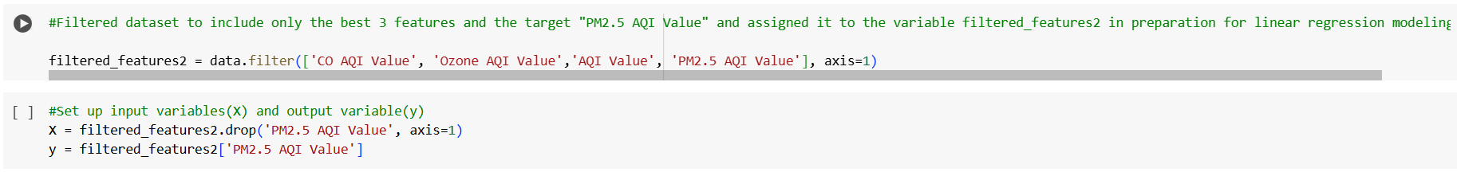
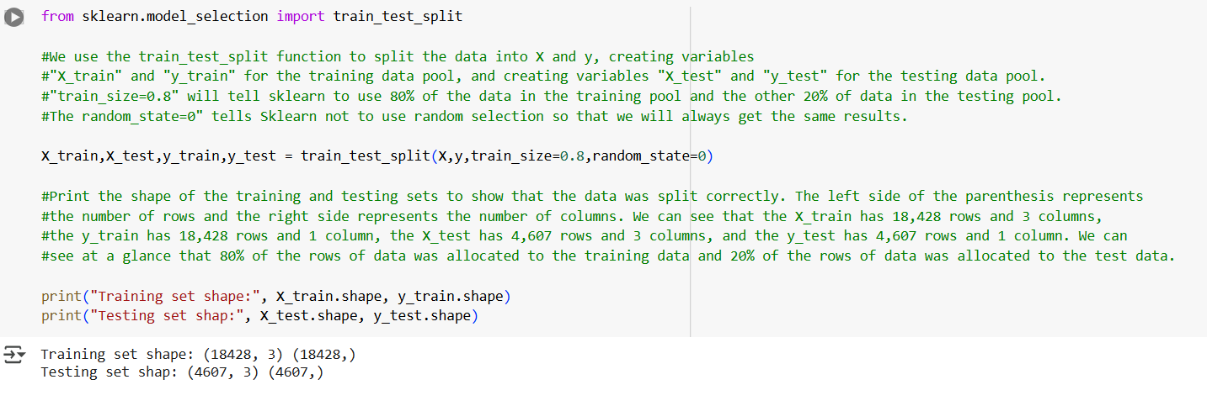
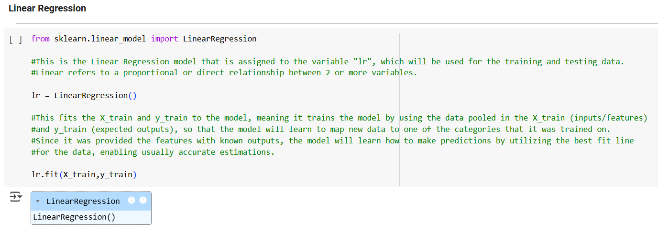
Multiple Linear Regression Model
A linear regression model involves the supervised learning (the use of labeled data to train a model) of a model, in which one continuous variable can be predicted based on the linear relationship between other input continuous features (Joy, 2025).
Input variables: The CO AQI Value, the Ozone AQI Value, and the AQI Value.
Target variable: The PM2.5 AQI Value.

Slide 14
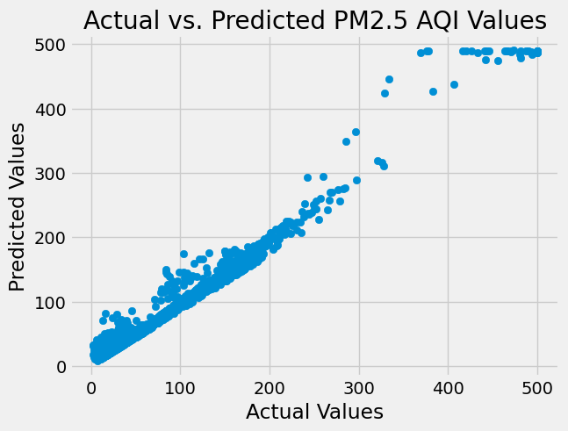
Multiple Linear Regression Model Results
Plot shows overall strong positive correlation between predicted PM2.5 AQI Values and the actual PM2.5 AQI Values.
Plot shows that PM2.5 AQI Values above 300 are less accurate than PM2.5 AQI Values below 300.
Intercept of the model is 1.82.
The model’s coefficients for the CO AQI Value, the Ozone AQI Value, and the AQI Value are respectively, 0.39, -0.13, and 0.98, which shows that the AQI Value has the strongest positive impact on the predicted PM2.5 AQI Values.
The MAE was 4.98, the MSE was 83.90, the RMSE was 9.16, and the R² was 0.98, which shows that the linear regression model has an overall great performance.

Slide 15
Multiple Linear Regression Model’s Actual vs Predicted Average PM2.5 AQI Values for the Top 10 Countries with the Highest and Lowest PM2.5 AQI, and the USA
Country | Actual Average PM2.5 AQI Value | Actual PM2.5 AQI Category | Predicted Average PM2.5 AQI Value | Predicted PM2.5 AQI Category
United States of America | 58.0 | Moderate | 57.9 | Moderate
India | 149.5 | Unhealthy for Sensitive Groups | 148.9 | Unhealthy for Sensitive Groups
Pakistan | 173.1 | Unhealthy | 173.6 | Unhealthy
Sweden | 21.0 | Good | 32.6 | Good
Finland | 21.6 | Good | 38.5 | Good
Senegal | 152.4 | Unhealthy | 150.1 | Unhealthy for Sensitive Groups
Uruguay | 21.7 | Good | 26.6 | Good
Norway | 18.6 | Good | 39.7 | Good
Papua New Guinea | 20.5 | Good | 19.6 | Good
Saudi Arabia | 149.3 | Unhealthy for Sensitive Groups | 166.2 | Unhealthy
Mauritania | 179.0 | Unhealthy | 164.5 | Unhealthy
United Arab Emirates | 152.7 | Unhealthy | 146.1 | Unhealthy for Sensitive Groups
Kuwait | 162.0 | Unhealthy | No prediction | No prediction
Iceland | 18.3 | Good | No prediction | No prediction
Andorra | 22.0 | Good | No prediction | No prediction
Solomon Islands | 6.0 | Good | No prediction | No prediction
Republic of Korea | 415.0 | Hazardous | No prediction | No prediction
Palau | 7.0 | Good | 15.4 | Good
Maldives | 15.0 | Good | No prediction | No prediction
Bahrain | 188.0 | Unhealthy | No prediction | No prediction
Aruba | 163.0 | Unhealthy | 159.4 | Unhealthy
All except three average PM2.5 AQI Value predictions matched the original PM2.5 AQI Category for each country.
Three countries’ actual vs. predicted average PM2.5 AQI Values were close, but only differed by one PM2.5 AQI Category.

Slide 16
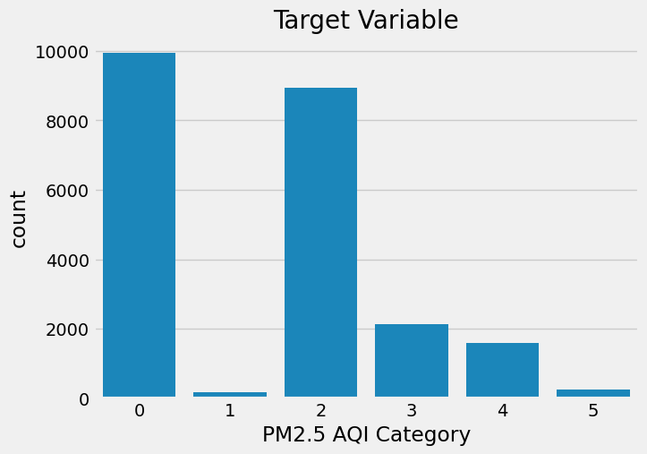
Classification Models
In order to find the optimal performing classification model, several types of classification models were created, trained, tested, and compared.
The classification types modeled include, a Gradient Boosting decision tree model, a Random Forest decision tree model, and two Support Vector Machine (SVM) models.
Input variables: Country, the CO AQI Value, the Ozone AQI Value, and the AQI Value.
Target variable: The PM2.5 AQI Category
Country and PM2.5 AQI Category encoded before training.
The encoding for the PM2.5 AQI Category mapped 0 to Good, 1 to Moderate, 2 to Unhealthy for Sensitive Groups, 3 to Unhealthy, 4 to Very Unhealthy, and 5 to Hazardous

Slide 17
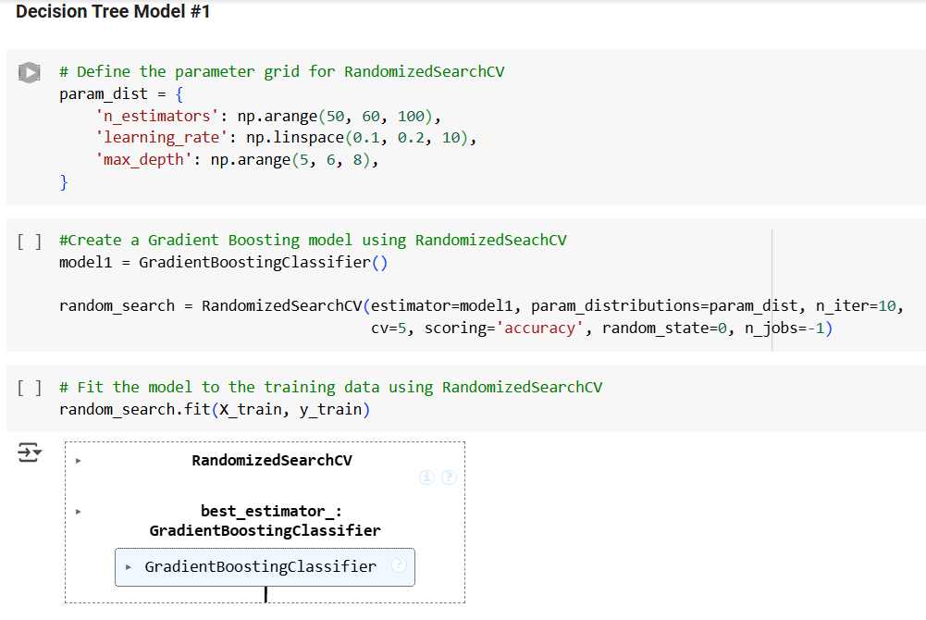
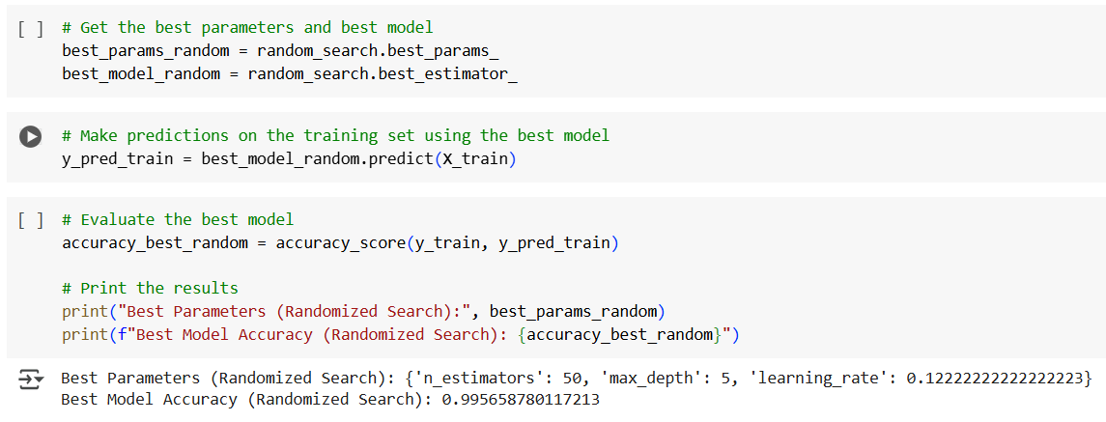
Decision Tree Model #1: Gradient Boosting
A Gradient Boosting decision tree model uses ensemble learning, which combines many weak and slow learning models to form one strong learning model, reducing overfitting (GeeksforGeeks, 2025; machinelearningplus, 2025).
Created model using RandomizedSeachCV, which randomly samples different combinations of hyperparameters from the parameter grid.
The overall accuracy was 99%.
The overall precision, recall, and F1-score were 96%.

Slide 18
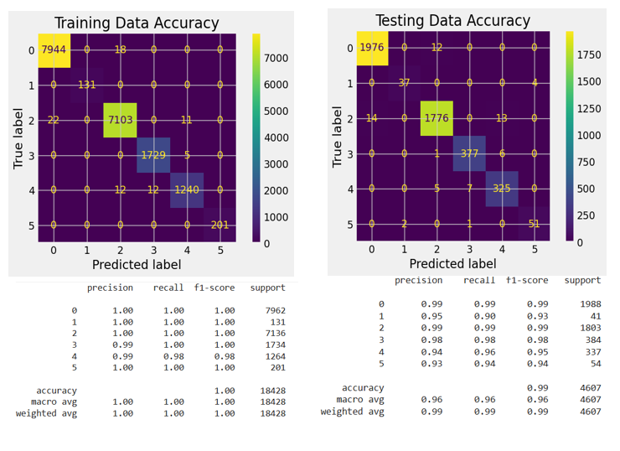
Decision Tree Model # 1 Confusion Matrixes and Classification Reports
The overall evaluation for both the training data and testing data shows that the model is very overfitted, especially since the training data had 100% scores for all metrics.

Slide 19
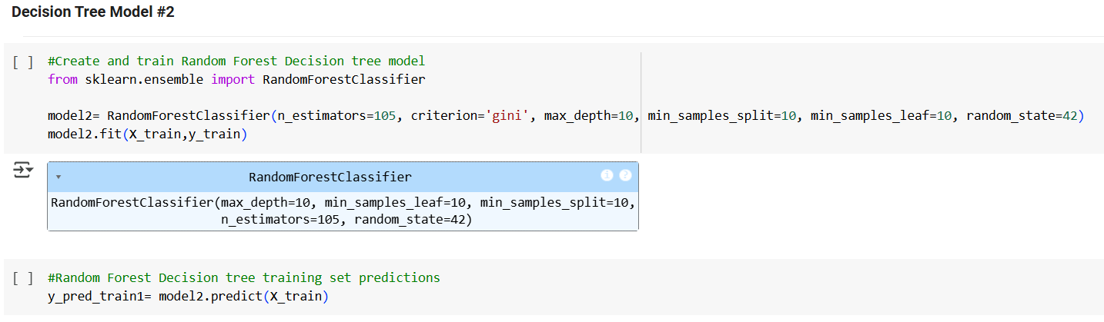
Decision Tree Model #2: Random Forest
A Random Forest decision tree model trains many different decision trees in parallel and uses a majority vote of predictions from the results from all trees (GeeksforGeeks, 2025; machinelearningplus, 2025).
The overall accuracy was 98%.
The overall precision, recall, and F1-score were 96%.

Slide 20
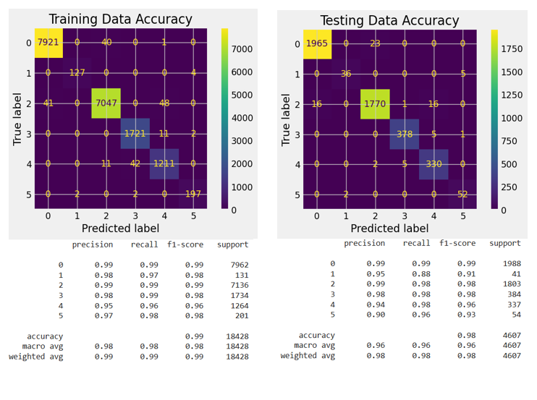
Decision Tree Model # 2 Confusion Matrixes and Classification Reports
The overall evaluation for both the training data and testing data shows that the Random Forest model is overfitted, but not as much as the GradientBoostingClassifier model.

Slide 21
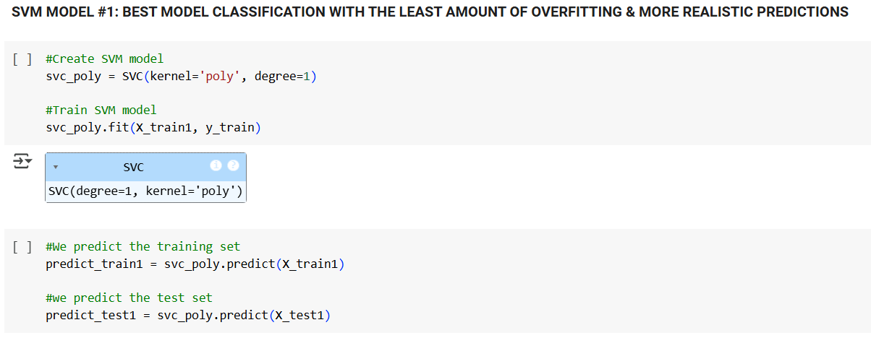
SVM Model # 1: The Best Classification Model
SVM models perform classification by finding the best boundary or hyperplane that separates data into different classes (GeeksforGeeks, 2023).
The data was normalized to the same standard scale before training and testing.
The overall accuracy was 95%.
The overall precision was 92%.
The overall recall was 90%.
The overall F1-score was 91%.

Slide 22
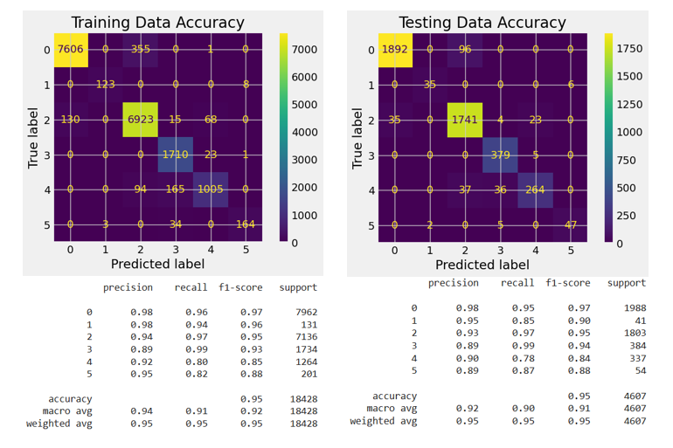
SVM Model # 1 Confusion Matrixes and Classification Reports
Since the overall accuracy is exactly the same (95%) for both the training data and testing data, the data seems to fit the SVM Model #1 perfectly.

Slide 23
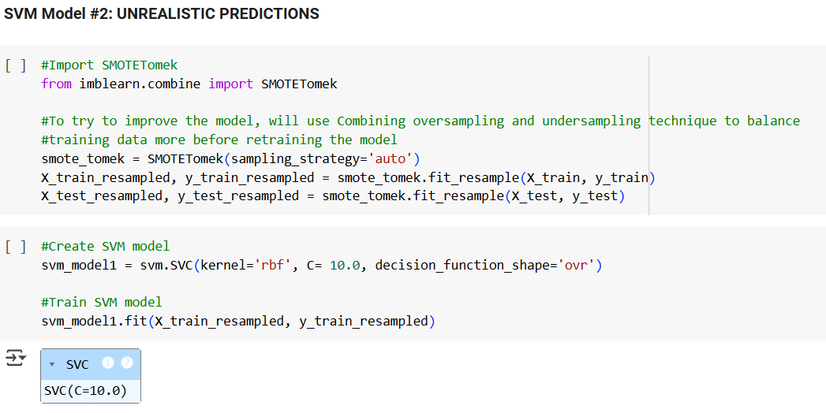
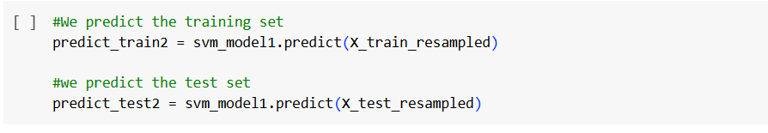
SVM Model # 2: Unrealistic Predictions
The data was normalized to the same standard scale before training and testing.
A combining oversampling and undersampling technique was used to better balance the training and testing data before training the model.
The overall accuracy was 95%.
The overall precision was 96%.
The overall recall and F1-score were 95%.

Slide 24
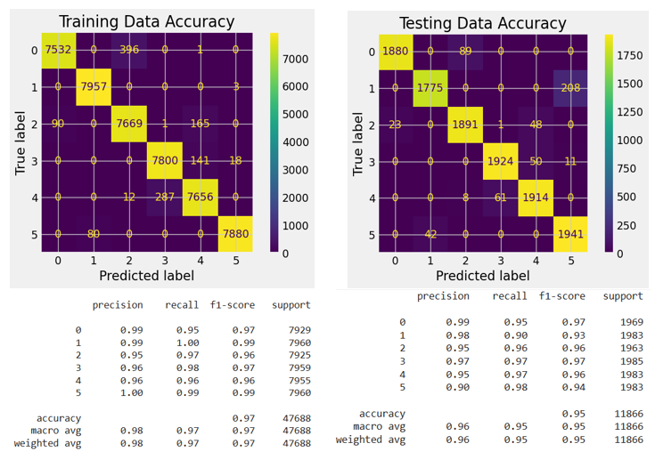
SVM Model # 2 Confusion Matrixes and Classification Reports
When comparing the metrics for the training and testing data, the SVM Model #2 is overfitted less than the RandomForestClassifier decision tree model, but more than the SVM Model #1.
Using the combination of oversampling and undersampling did not help improve model predictions, it actually led to the model making close proportions of predictions for all 6 classes, which is very unrealistic for this dataset.

Slide 25
Comparison of Classification Models’ Performance Metrics
Model | Accuracy | Overall Precision | Overall Recall | Overall F1-Score
Decision Tree Model #1 (Using Training Data) | 1.00 | 1.00 | 1.00 | 1.00
Decision Tree Model #1 (Using Testing Data) | 0.99 | 0.96 | 0.96 | 0.96
Decision Tree Model #2 (Using Training Data) | 0.99 | 0.98 | 0.98 | 0.98
Decision Tree Model #2 (Using Testing Data) | 0.98 | 0.96 | 0.96 | 0.96
SVM Model #1 (Using Training Data) | 0.95 | 0.94 | 0.91 | 0.92
SVM Model #1 (Using Testing Data) | 0.95 | 0.92 | 0.90 | 0.91
SVM Model #2 (Using Training Data) | 0.97 | 0.98 | 0.97 | 0.97
SVM Model #2 (Using Testing Data) | 0.95 | 0.96 | 0.95 | 0.95

Slide 26
Comparison of Classification Models’ Performance on Testing Data
Model | Percentage of Correct “Good” Classifications (Precision) | Percentage of Correct “Moderate” Classifications (Precision) | Percentage of Correct “Unhealthy for Sensitive Groups” Classifications (Precision) | Percentage of Correct “Unhealthy” Classifications (Precision) | Percentage of Correct “Very Unhealthy” Classifications (Precision) | Percentage of Correct “Hazardous” Classifications (Precision)
Decision Tree Model #1 | 99% | 95% | 99% | 98% | 94% | 93%
Decision Tree Model #2 | 99% | 95% | 99% | 98% | 94% | 90%
SVM Model #1 | 98% | 95% | 93% | 89% | 90% | 89%
SVM Model #2 | 99% | 98% | 95% | 97% | 95% | 90%

Slide 27
Review of Data Models
The multiple linear regression model had an overall great performance, but struggles with non-linear data that occurs when the PM2.5 AQI Values increases above 300.
It was determined that the most reliable and most accurate classification model with the least amount of overfitting was the SVM Model #1.
The overall accuracy for SVM Model #1 was 95%, staying consistent between the training and testing data.
The SVM Model #1 is best at accurately classifying the “Good” PM2.5 AQI Category, is good at accurately classifying the “Moderate” and “Unhealthy for Sensitive Groups” PM2.5 AQI Categories, but can use some improvement in more accurately classifying the “Unhealthy”, “Very Unhealthy”, and “Hazardous” PM2.5 AQI Categories.

Slide 28
Final Results
The dataset contains air pollution data for only 89.7% of existing countries.
There is insufficient or missing air pollution data for some countries, most likely due to the lack of high-quality air pollution monitoring systems or air pollution sensors and/or faulty low-cost air pollution sensors, and due to some governments not making their data public.
104 countries (includes 4088 cities) have PM2.5 AQI Values greater than 100, which indicates that there is poor air quality in 59.4% of all counties in the dataset.
Asian and African countries have the worst average PM2.5 AQI Values.
The top ten countries with the highest average PM2.5 AQI Values include, Republic of Korea, Bahrain, Mauritania, Pakistan, Aruba, Kuwait, United Arab Emirates, Senegal, India, and Saudi Arabia.
The top ten countries with the lowest average PM2.5 AQI Values include, Andorra, Uruguay, Finland, Sweden, Papua New Guinea, Norway, Iceland, Maldives, Palau, and Solomon Islands.

Slide 29
Final Results Continued
The USA has the average PM2.5 AQI Value in the moderate air quality range.
The top ten countries with the most predictions represented in the data include, the USA, India, China, Brazil, Germany, Somalia, Finland, Turkey, Japan, and the Neverlands.
The evaluation and visualization of PM2.5 AQI Value predictions by country for the multiple linear regression model showed that the model made very accurate predictions that were close to the actual PM2.5 AQI Values.
The evaluation and visualization of PM2.5 AQI Category predictions by country for the SVM Model #1 showed that the model made relatively good predictions with minimal error, but can use more finer hyperparameter tuning and optimization to improve the model’s performance.

Slide 30
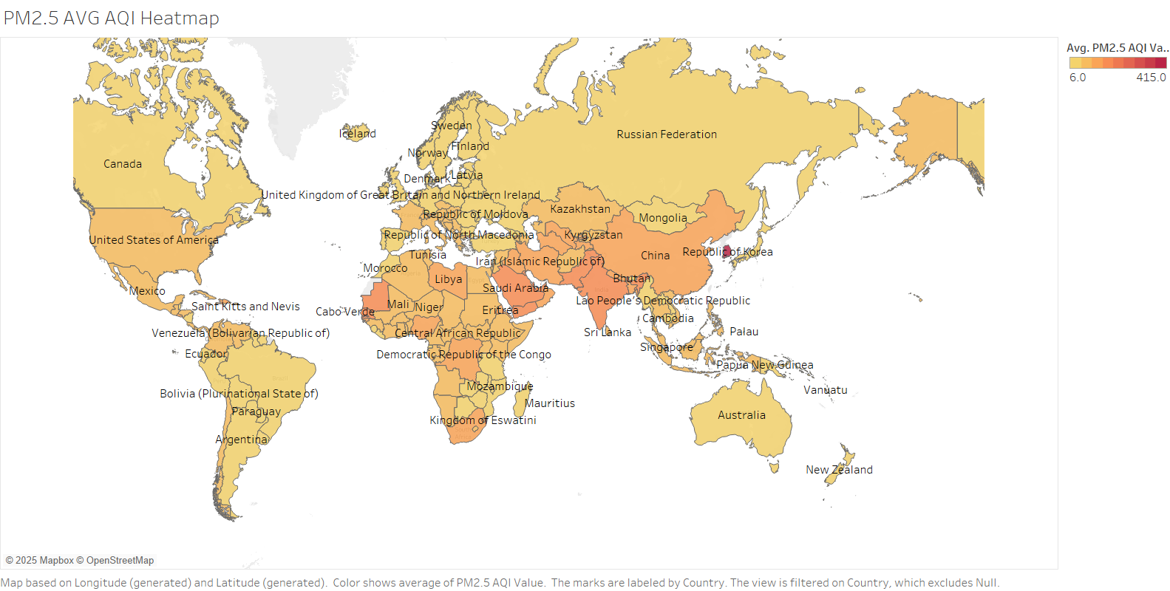
Tableau Global Heatmap showing the Average PM2.5 AQI Values for different countries

Slide 31
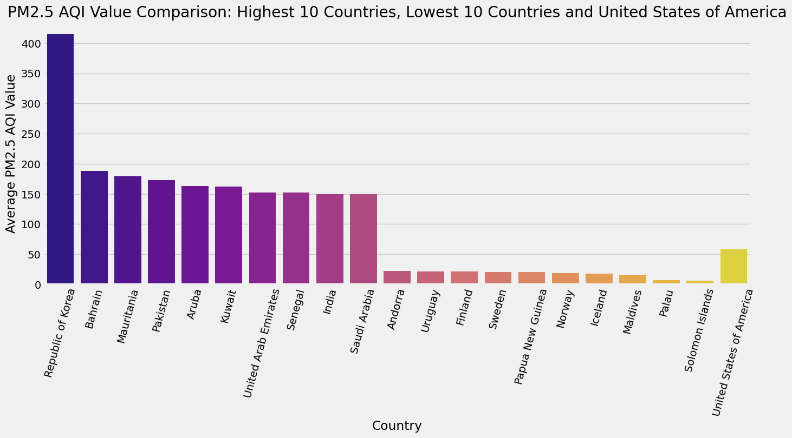
Average PM2.5 AQI Values in the original data set from the Highest 10 Countries, Lowest 10 Countries, and the USA
Looking at the bar graph, we can see how the USA compares to the countries with the highest and lowest average PM2.5 AQI Values

Slide 32
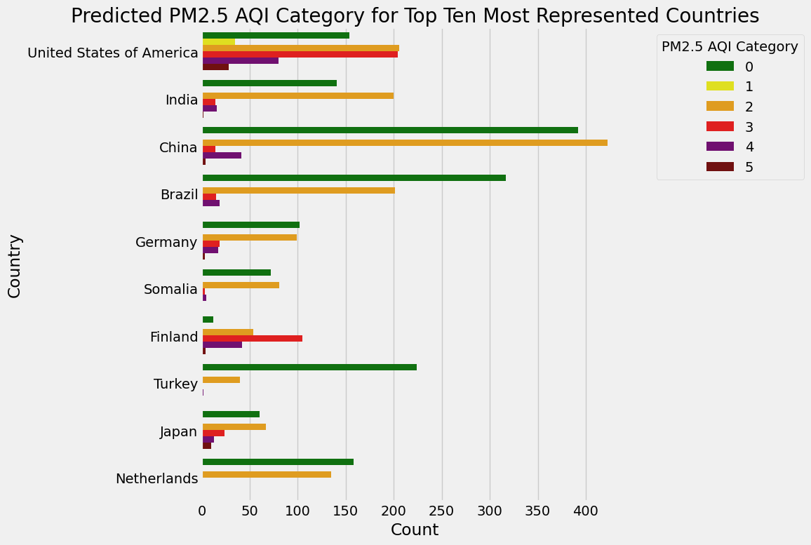
SVM Model #1 Predicted PM2.5 AQI Category for Top Ten Most Represented Countries in the Test Data

Slide 33
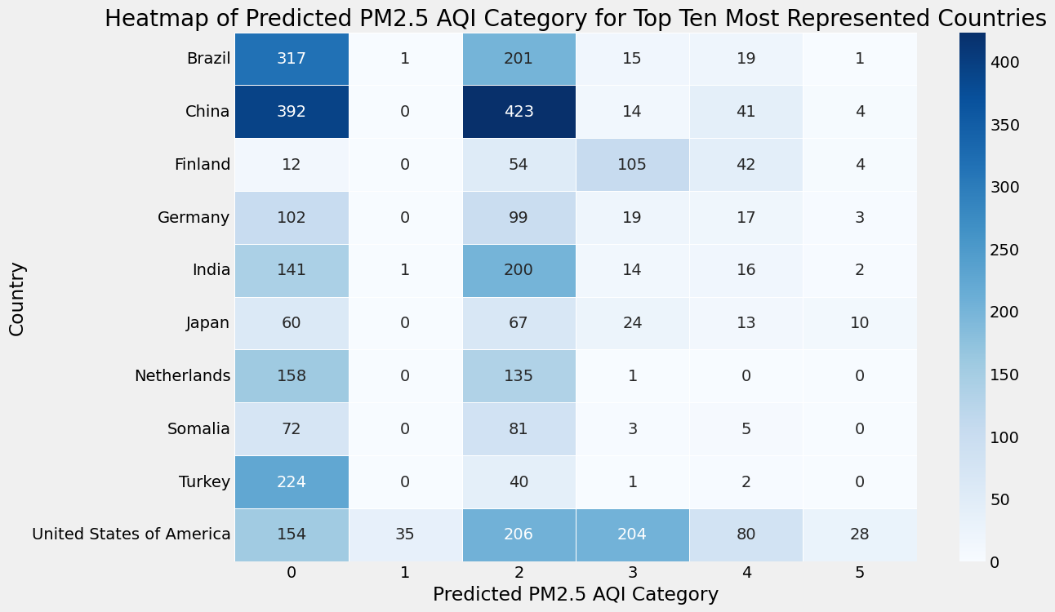
SVM Model #1 Heatmap of Predicted PM2.5 AQI Category for Top Ten Most Represented Countries in the Test Data
China had the highest number of Good and Unhealthy for Sensitive Groups PM2.5 AQI Category predictions.
The USA had the highest number of Moderate, Unhealthy, Very Unhealthy, and Hazardous PM2.5 AQI Category predictions.
Turkey had the lowest number of Unhealthy for Sensitive Groups PM2.5 AQI Category predictions.
The Neverlands and Turkey both had the lowest number of Unhealthy PM2.5 AQI Category predictions.
The Neverlands was the only country that did not have any predictions for the Very Unhealthy PM2.5 AQI Category.
The Neverlands, Somalia, and Turkey were the only three countries that did not have any predictions for the Hazardous PM2.5 AQI Category.

Slide 34
Recommendations for Future Analysis
Collecting more data, which leads to better performing models.
Incorporating additional features to further enhance models, such as emissions sources, hourly analysis to pinpoint timeframes when pollution levels peak, and population weighted annual average concentration for each country by calculating the PM2.5 per Capita to provide the level of exposure per person enabling a more equal comparison between countries.
Use model ensembling, which is a better approach to model selection and has been proven to be better than any single model since it corrects for errors of each individual model, which was demonstrated in a Kaggle competition described by Al-Taie et al. (2017).

Slide 35
Lessons Learned
It is important to do the necessary research to gain a thorough understanding of the problem and the data, and how the data can be analyzed to provide meaningful insights.
I learned through exploratory data analysis that the dataset has data quality issues.
All models are not equal and all models have different challenges and limitations.
Using a technique to balance classes for global pollution data can lead to a model making unrealistic predictions.
Due to data limitations for the Global Air Pollution Dataset, the models created for this project may not fully capture the true aspects of PM2.5 air pollution for some countries or regions and with the limited amount of data available, any comparisons made between countries may be inaccurate.

Slide 36
Lessons Learned Continued
This project revealed that there is insufficient air pollution data available for some countries that is not just an issue with this dataset, but is an issue pertaining to all global air pollution data due to the lack of high-quality air pollution monitoring systems or air pollution sensors and/or faulty low-cost air pollution sensors, and also due to some governments not making their data public.
To provide more usable insights for policy makers, it may be necessary to incorporate hourly analysis, emission sources, and population data.
To provide better performing models, it may be best to use model ensembling.
A high accuracy does not necessarily mean that the model is making realistic or meaningful predictions.

Slide 37
References
AirNow. (n.d.). Air quality index (AQI) basics. Retrieved January 8, 2025, from
https://www.airnow.gov/aqi/aqi-basics/
Al-Taie, M, Salim, N. & Obasa, A. (2017). Successful data science projects: Lessons learned from kaggle competition. Kurdistan
Journal of Applied Research, 2(3), 40–49. https://doi-org.ezproxy.umgc.edu/10.24017/science.2017.3.18
eLichens. (2024). Global air quality map. https://www.elichens.com/global-air-quality-map
GeeksforGeeks. (2024, February 29). How to tune hyperparameters in gradient boosting algorithm. Retrieved from
https://www.geeksforgeeks.org/how-to-tune-hyperparameters-in-gradient-boosting-algorithm/
GeeksforGeeks. (2025, January 16). Random forest algorithm in machine learning. https://www.geeksforgeeks.org/random-forest-algorithm-in-
machine-learning/
GeeksforGeeks. (2023, May 07). Support vector machine in machine learning. https://www.geeksforgeeks.org/support-vector-machine-in-machine-l
earning/
Health Effects Institute. (2024). State of global air 2024. Special Report. https://www.stateofglobalair.org/resources/report/state-
global-air-report-2024
Hunter, P. (2020). The health toll of air pollution: Despite global efforts to clean up the air, outdoor and indoor air
pollution still have a drastic negative effect on public health. EMBO Reports, 21(8), 1-4.
https://doi.org/10.15252/embr.202051183
Joy, A. P. (2025, February 5). A beginner’s guide to linear regression: Understanding the fundamentals.
https://www.skillcamper.com/blog/a-beginners-guide-to-linear-regression-understanding-the-fundamentals#What-is-Linear-Regression

Slide 38
References Continued
machinelearningplus. (2025). An introduction to gradient boosting decision trees. https://www.machinelearningplus.com/machine-learning/an-
introduction-to-gradient-boosting-decision-trees/
Muzdadid, H. A. (2022). Global air pollution dataset [Data set]. Kaggle.
https://www.kaggle.com/datasets/hasibalmuzdadid/global-
air-pollution-dataset/data
Strebkov, Y. (n.d.). Polluted planet earth photo. Retrieved from https://thumbs.dreamstime.com/z/d-
rendering-polluted-planet-earth-pipes-smoke-global-atmospheric-pollution-close-up-154298122.jpg
Tableau. (2025). What is a tree map? Understanding and using tree maps. https://www.tableau.com/chart/what-is-treemap
World Health Organization. (2025). Air pollution. https://www.who.int/health-topics/air-pollution#tab=tab_1

